Slide 1
WELCOME
TO OUR
PROJECT

Slide 2
Manage Your Funds in a Smart Way

Slide 3
A project work by______
Tajim Md. Niamat Ullah Akhund;
Momin Ahmed
Imran Hossain
Shouvik Sarkar
Raju Sheikh

Slide 4
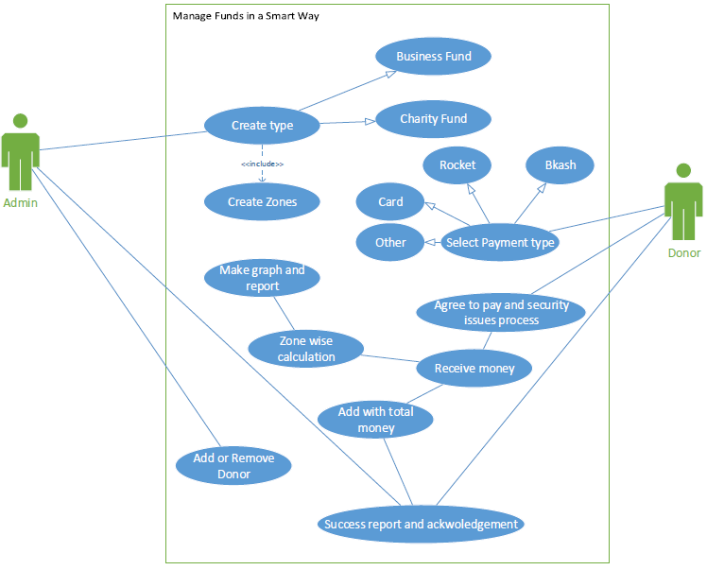
Use case Diagram of Our Project

Slide 5
Let’s See Our Project In User/Front Site

Slide 6
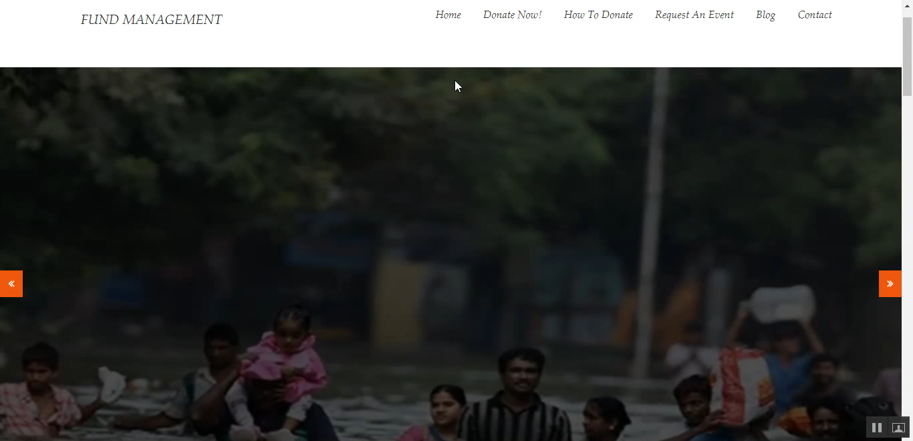
Front HOME page

Slide 7
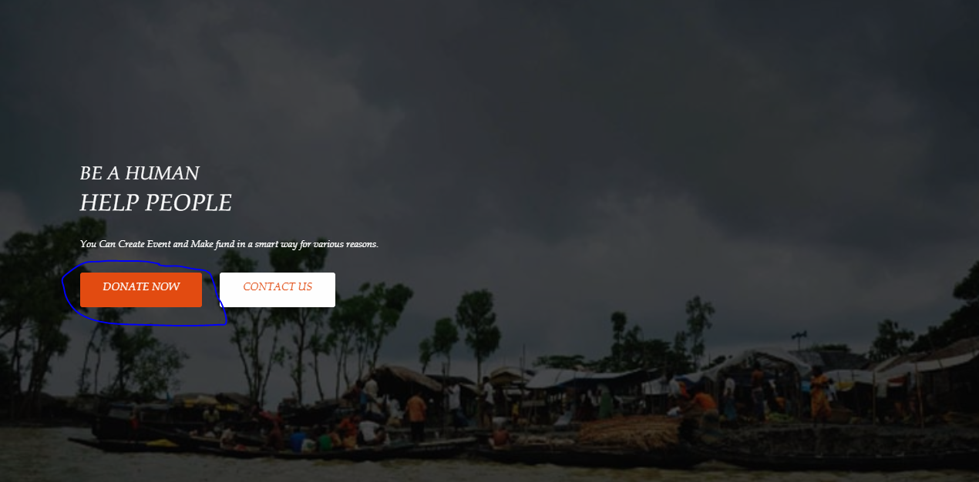
Donating option 1

Slide 8
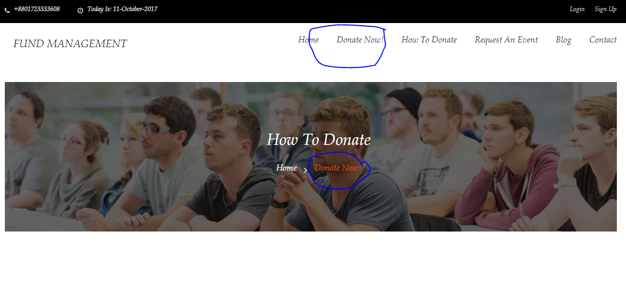
Donating option 2

Slide 9
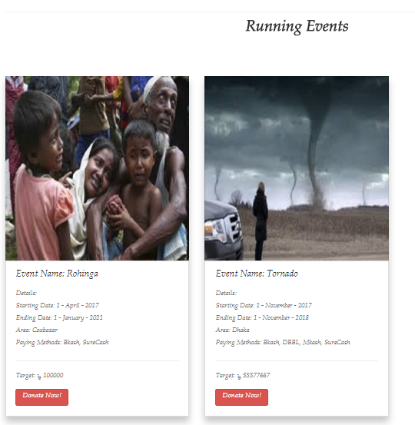
Donating
By click on Donate Now Button

Slide 10
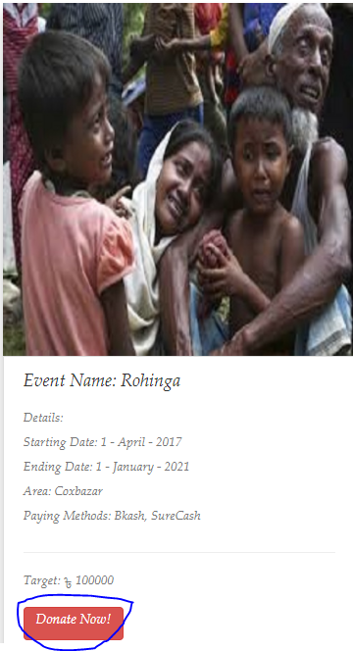
Donating
By click on Donate Now Button

Slide 11
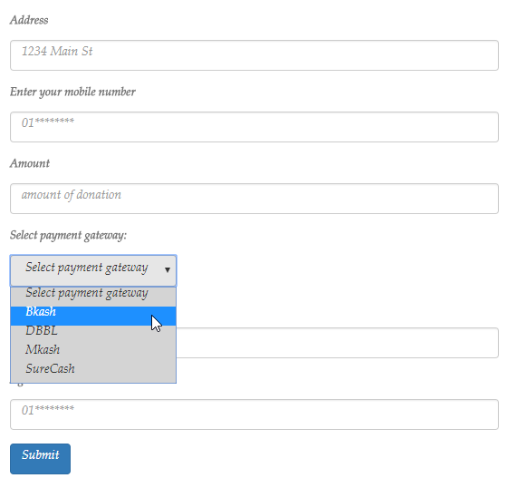
Donating form

Slide 12
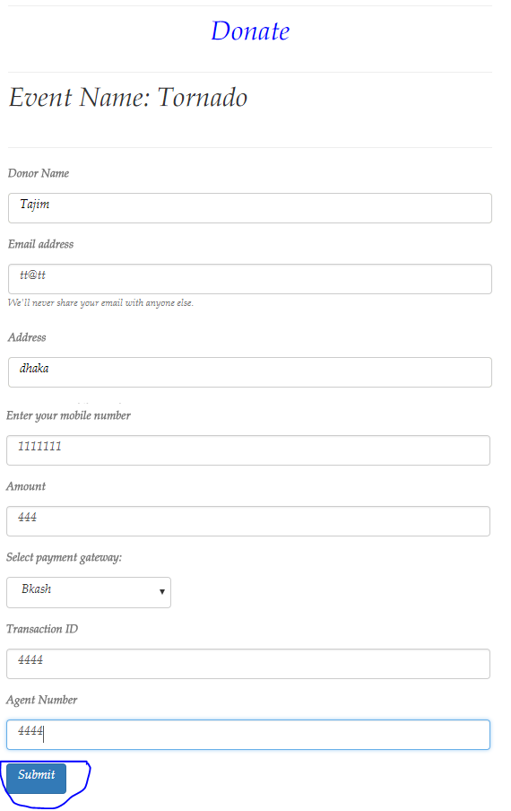
Donating form

Slide 13
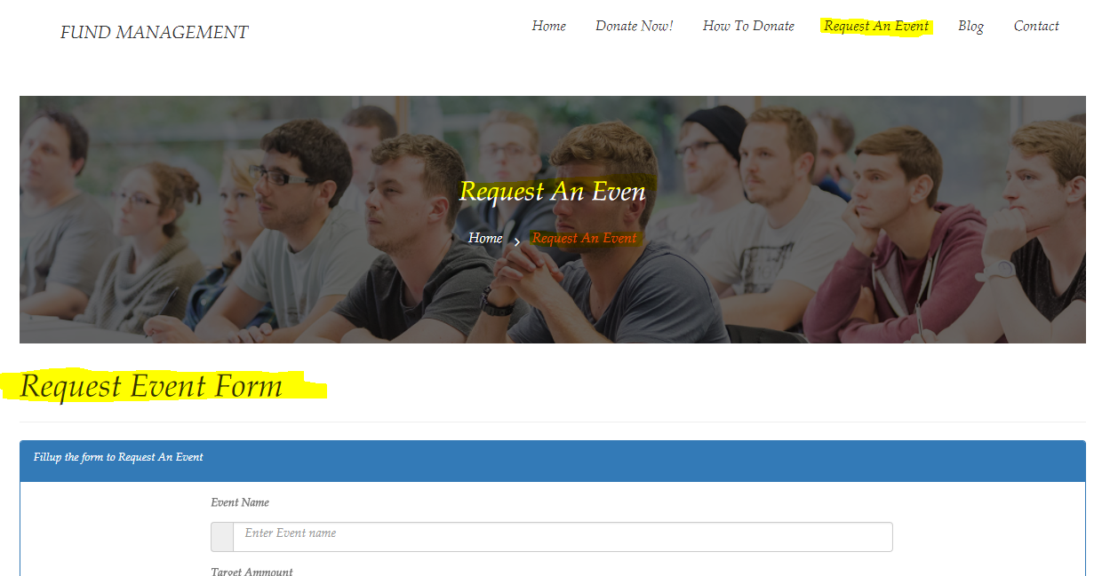
Request an Event

Slide 14
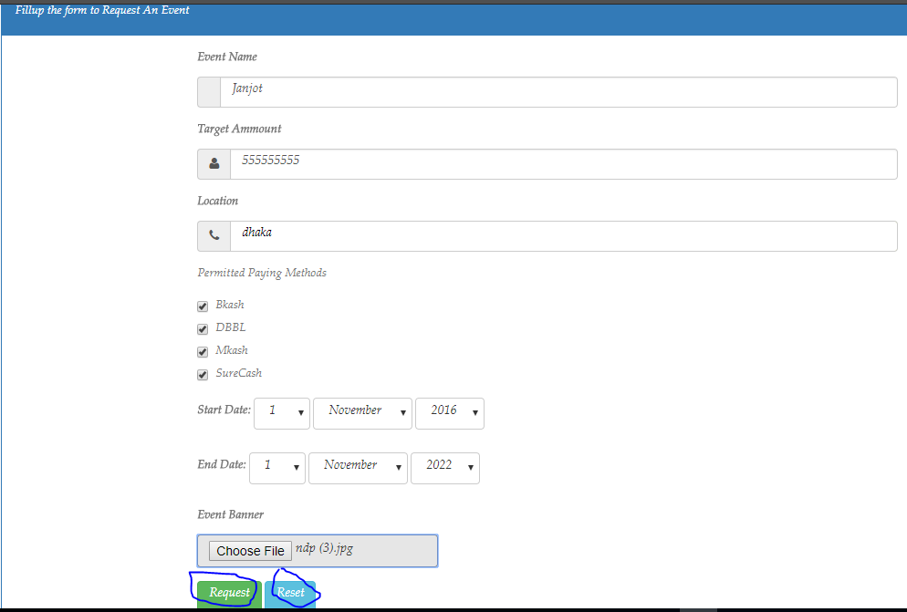
Request an Event

Slide 15
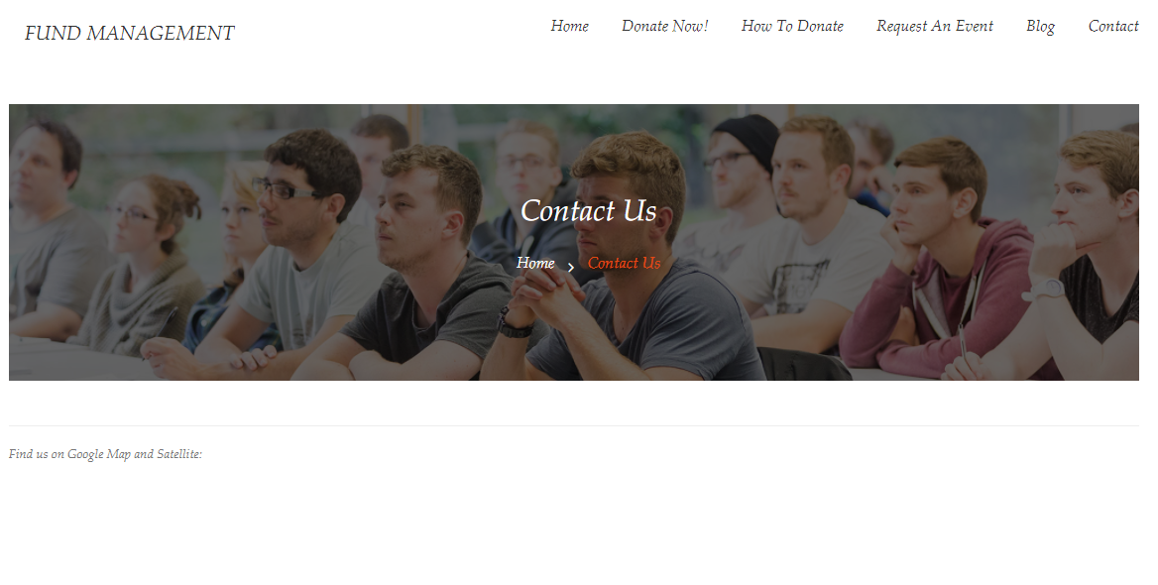
Contact us page with gogle map

Slide 16
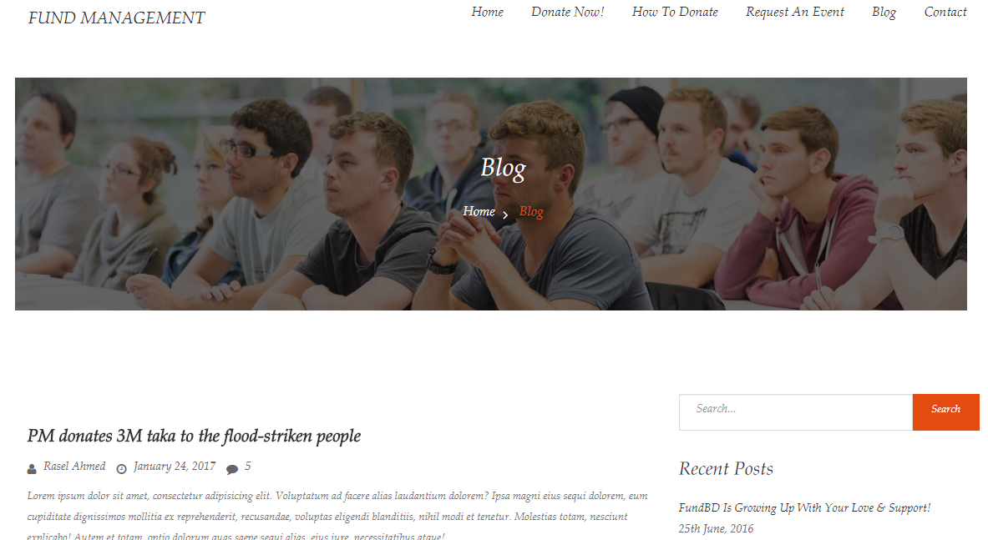
Blog page for suggestion and discussion

Slide 17
Let’s See Our Project Admin Site

Slide 18
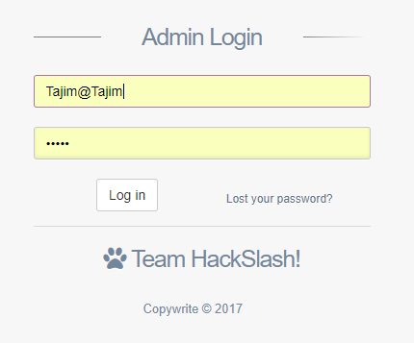
Log in for admin page

Slide 19
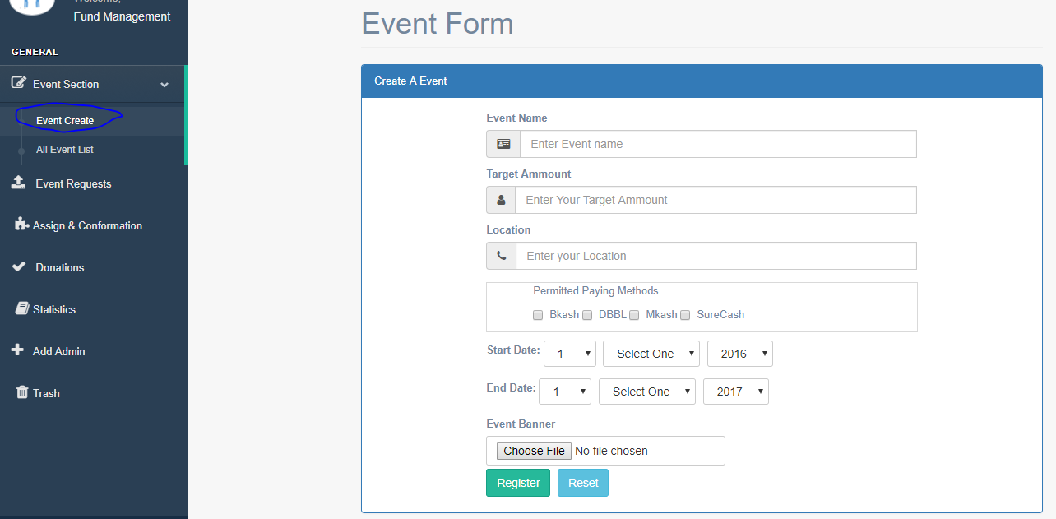
Admin can create event

Slide 20
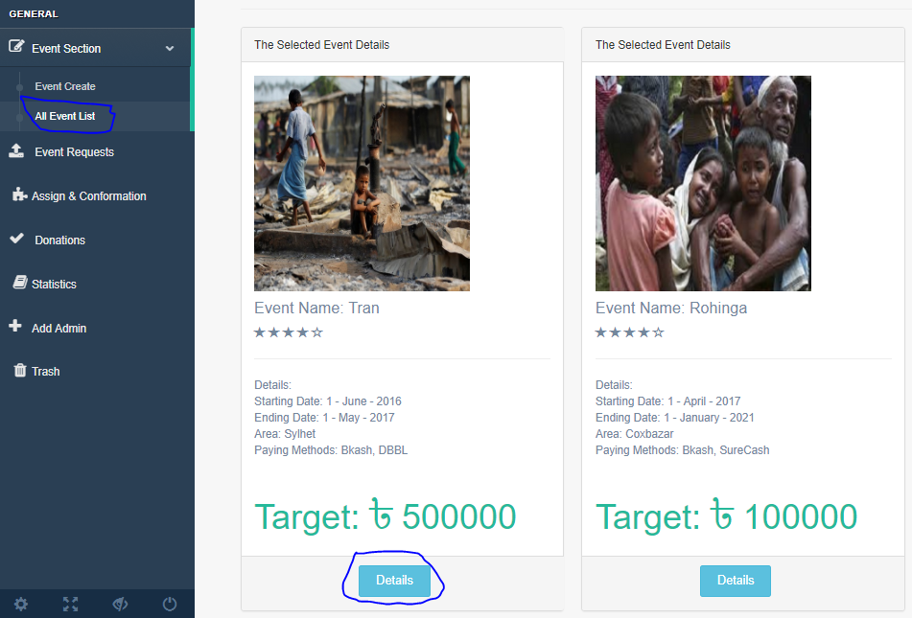
Admin can see all the events details

Slide 21
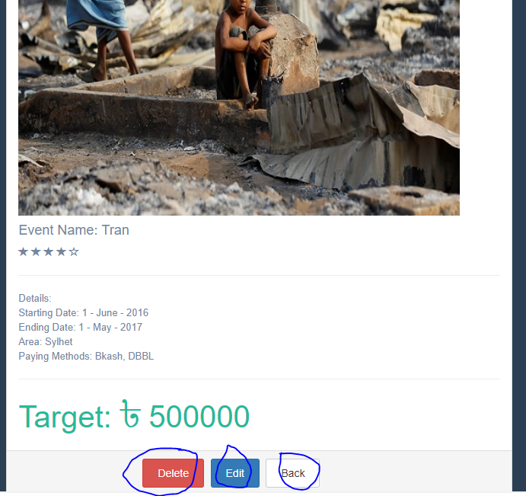
Admin can edit, update and delete all the events.

Slide 22
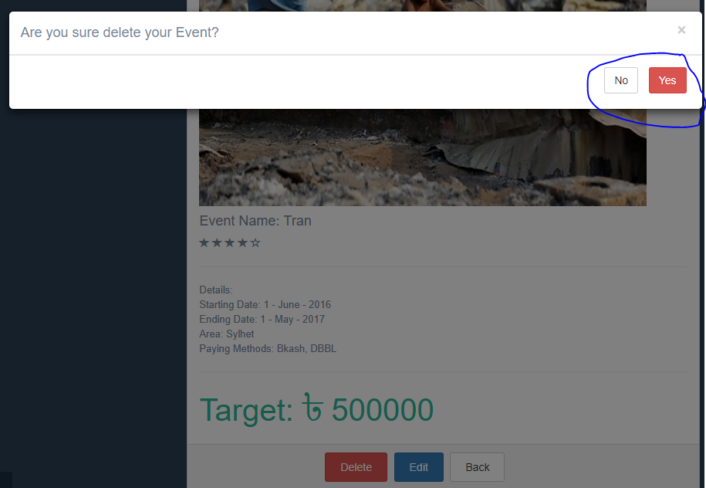
We add the soft delete feature

Slide 23
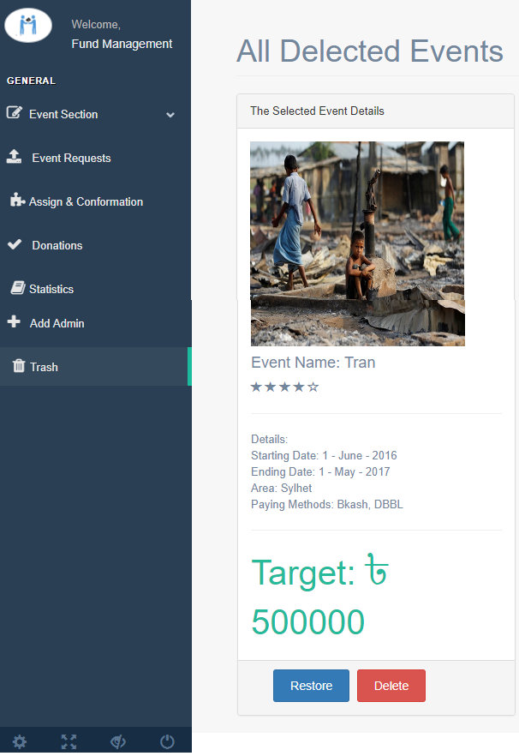
Softly deleted events will be appear in Trash page.
Admin can restore and permanently delete it from here.

Slide 24
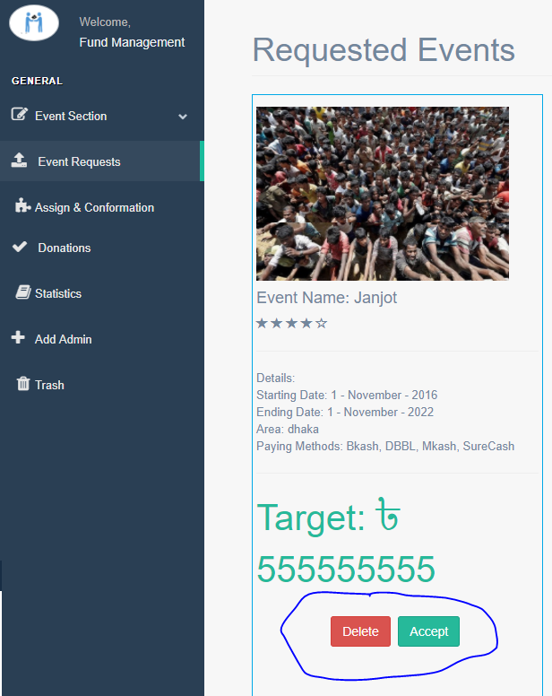
The requested events will be shown in Event Request Page.
Admin can Accept or delete the Requested event from here.

Slide 25
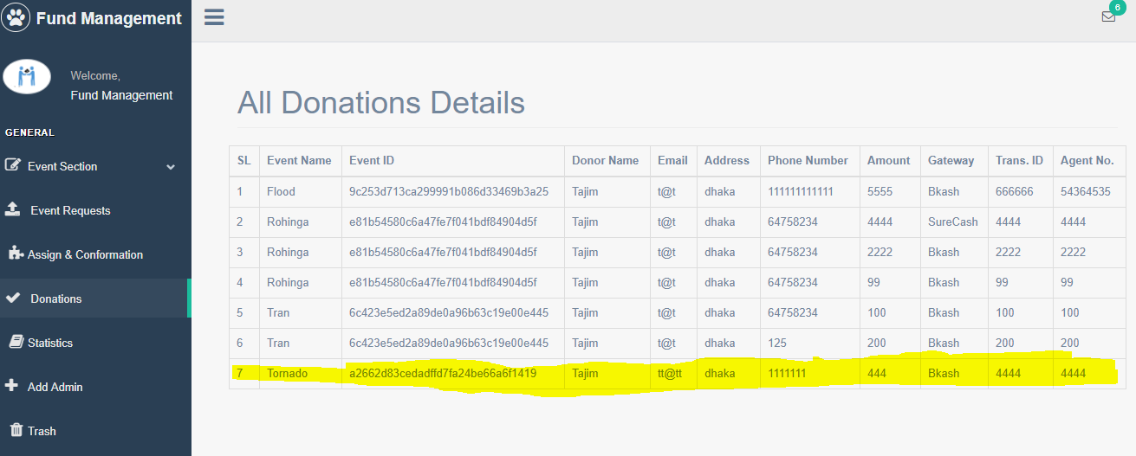
Admin can See all donations details from here

Slide 26
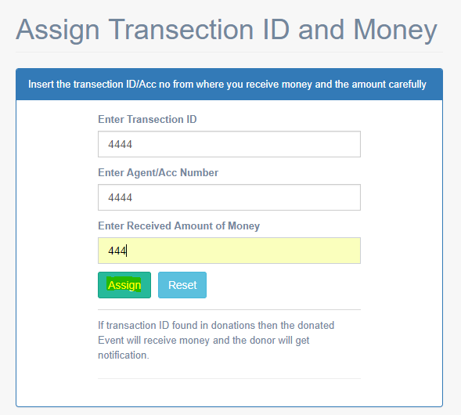
Admin can assign Transaction ID and money

Slide 27
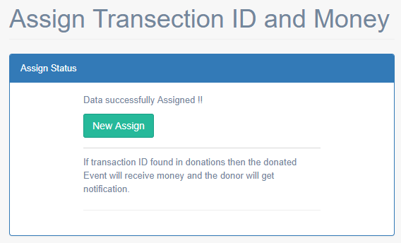
Admin can assign Transaction ID and money

Slide 28
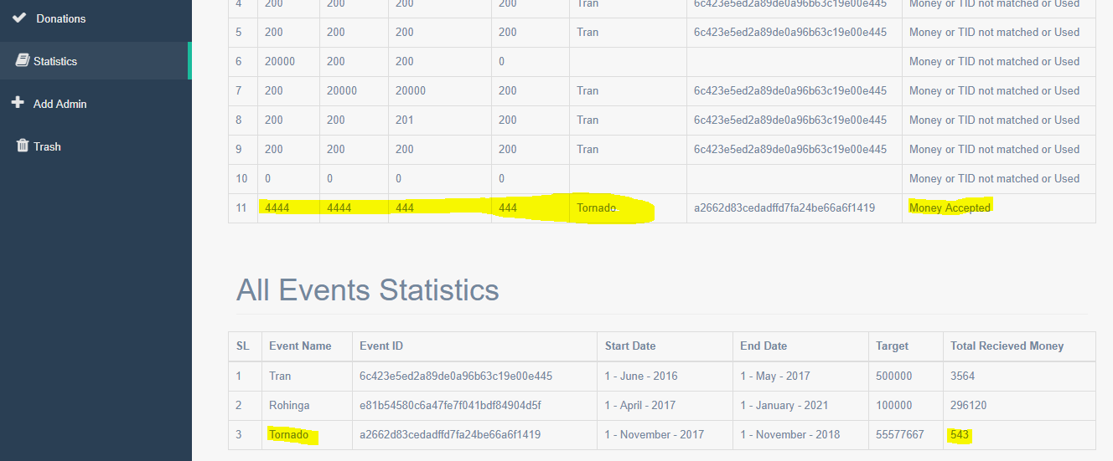
Successfully assigned money will be added in the respected event (that can not be deleted by admin)

Slide 29
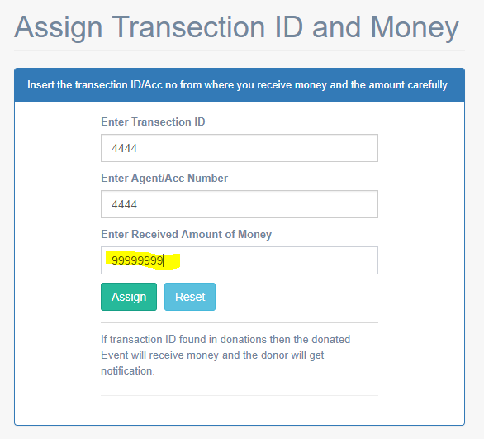
One TID can be assigned for one time only.

Slide 30
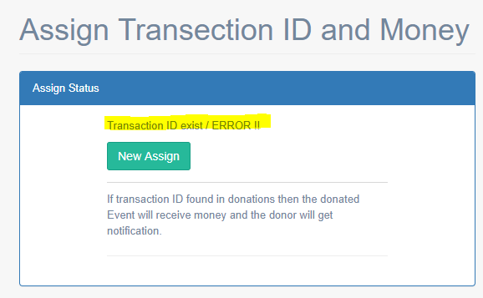
One TID can be assigned for one time only.

Slide 31
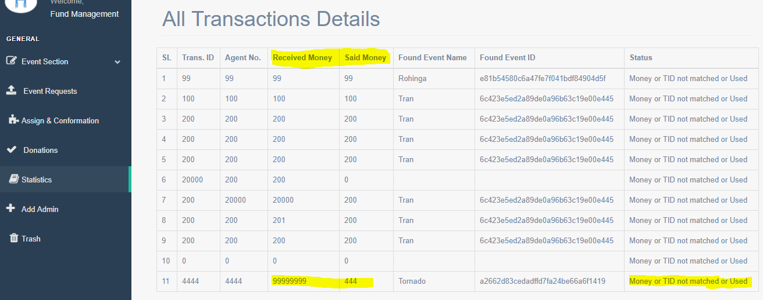
Wrong assigned money will not be accepted

Slide 32
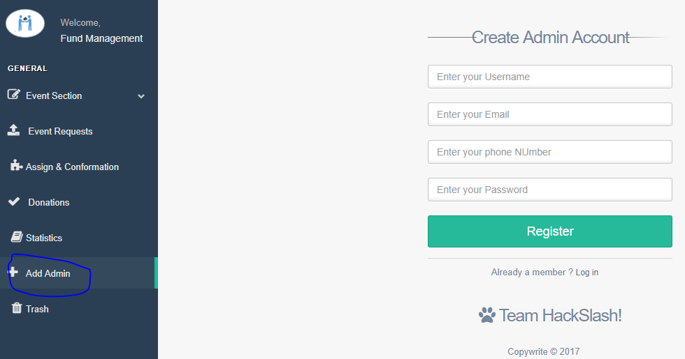
Only A registered logged in Admin can add another admins

Slide 33
Thank
You

